Slide 1
What do you see?
Notes:
Interest Approach:
The flamboyantly-colored mosquito pictured here is known as Sabethes cyaneus, and is a natural inhabitant of the Panamanian forest canopy. This particular specimen, which had landed on the photographer’s hand, was an offspring of a colony of mosquitoes that had been raised in captivity at Ohio State University, and in its larval form, had been sent to the Centers for Disease Control and Prevention (CDC), where it hatched, and was subsequently photographed. Note its brilliant iridescent purple, blue and gold coloration, as well as the large, feather-shaped mass of setae adorning the tibiae of its middle pair of jointed legs. See PHIL 15781, for another view of this mosquito in an environmental setting.

Slide 2
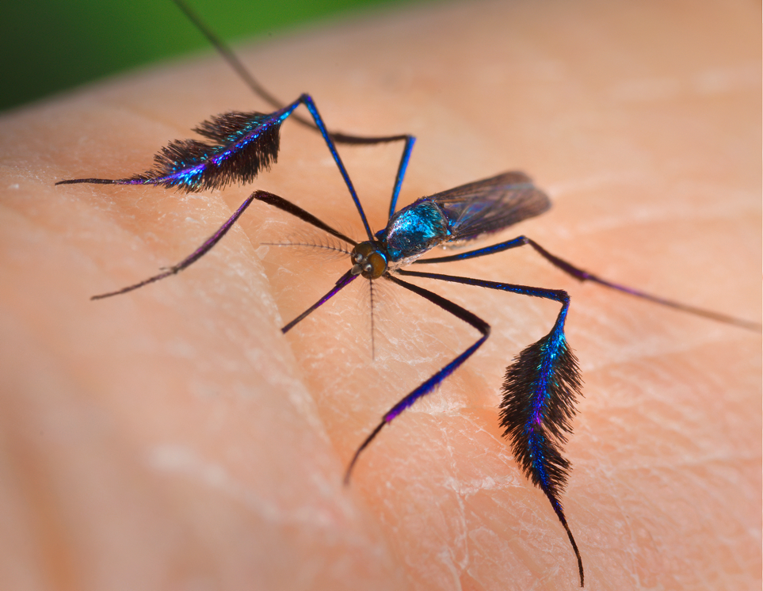
Mosquitoes
Photograph by James Gathany, Centers for Disease Control and Prevention
Notes:
Interest Approach:
The flamboyantly-colored mosquito pictured here is known as Sabethes cyaneus, and is a natural inhabitant of the Panamanian forest canopy. This particular specimen, which had landed on the photographer’s hand, was an offspring of a colony of mosquitoes that had been raised in captivity at Ohio State University, and in its larval form, had been sent to the Centers for Disease Control and Prevention (CDC), where it hatched, and was subsequently photographed. Note its brilliant iridescent purple, blue and gold coloration, as well as the large, feather-shaped mass of setae adorning the tibiae of its middle pair of jointed legs. See PHIL 15781, for another view of this mosquito in an environmental setting.

Slide 3
What is an insect?
6 legs
Photograph by Luis F. Aristizábal, University of Florida
Notes:
What makes an insect an insect?
They have 6 legs
Photograph by Luis F. Aristizábal, University of Florida.

Slide 4
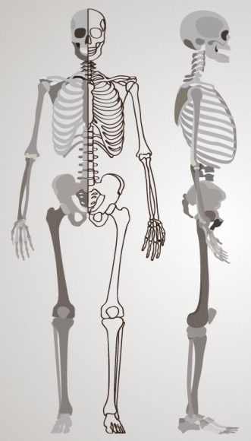
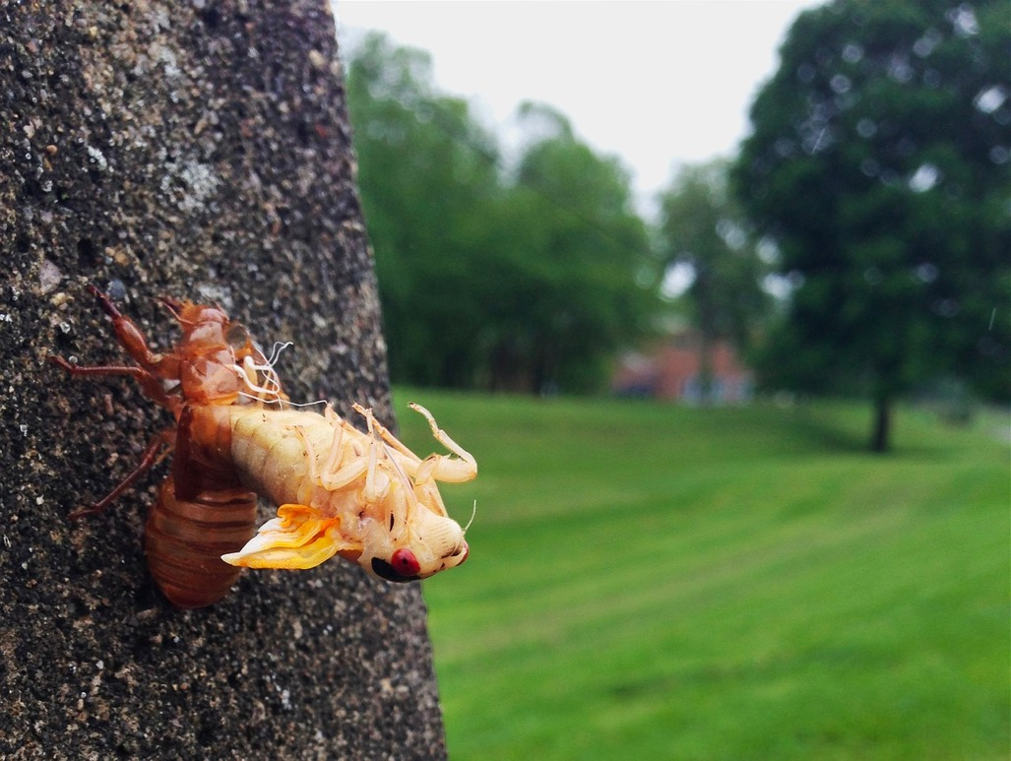
What is an insect?
6 legs
Exoskeleton
Graphic by freepik.com
Notes:
They also have an exoskeleton
Human skeleton graphic from https://www.freepik.com/free-photos-vectors/skeleton
Cicada photo came from https://pixabay.com/en/cicada-molting-ecdysis-shell-2222978/ and no attribution is required for the photo.

Slide 5
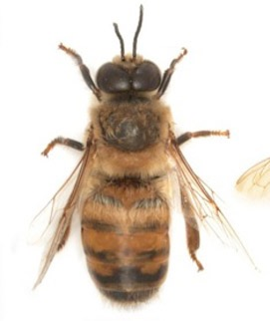
What is an insect?
Head
6 legs
Exoskeleton
3 body segments
Head
Thorax
Abdomen
Thorax
Abdomen
Photograph by Susan E. Ellis
Notes:
3 major body parts

Slide 6
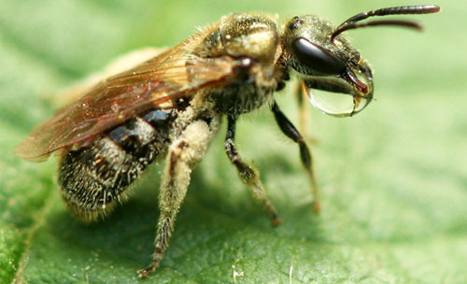
What is an insect?
Abdomen
Thorax
Head
6 legs
Exoskeleton
3 body segments
Head
Thorax
Abdomen
Photograph by Lynette Schimming, UF/IFAS Entomology Database
Notes:
Exoskeleton
6 legs
3 major body parts

Slide 7
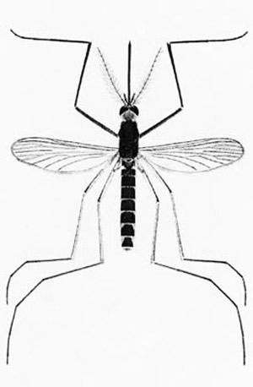
What about mosquitoes?
2 wings
Drawing by Carpenter and LaCasse, 1955 edition of Mosquitoes of North America.
Notes:
2 wings
Lay eggs on or near water
Bloodfeeding behavior
What are their mouthparts called?
Where do immature mosquitoes live

Slide 8
What about mosquitoes?
2 wings
Mouthpart = proboscis
Drawing by Carpenter and LaCasse, 1955 edition of Mosquitoes of North America.
Notes:
2 wings
Lay eggs on or near water
Bloodfeeding behavior
What are their mouthparts called?
Where do immature mosquitoes live

Slide 9
What about mosquitoes?
2 wings
Mouthpart = proboscis
Lay eggs on or near water
UF/IFAS File Photos
Notes:
2 wings
Lay eggs on or near water
Bloodfeeding behavior
What are their mouthparts called?
Where do immature mosquitoes live

Slide 10
What about mosquitoes?
Male
Female
2 wings
Mouthpart = proboscis
Lay eggs on or near water
Only females feed on blood
But all mosquitoes need sugar!
Notes:
2 wings
What are their mouthparts called?
Lay eggs on or near water
Bloodfeeding behavior
Where do immature mosquitoes live
Male and female mosquito picture came from Wikimedia commons https://commons.wikimedia.org/wiki/File:Aedes_aegypti_E-A-Goeldi_1905.jpg. Original is by Emil August Goeldi.

Slide 11
What about mosquitoes?
2 wings
Mouthpart = proboscis
Lay eggs on or near water
Only females feed on blood
But all mosquitoes need sugar!
Notes:
2 wings
What are their mouthparts called?
Lay eggs on or near water
Bloodfeeding behavior
Where do immature mosquitoes live
Sugar-feeding mosquito picture comes from https://commons.wikimedia.org/wiki/File:Mosquito_on_Flower.JPG

Slide 12
What about mosquitoes?
2 wings
Mouthpart = proboscis
Only females feed on blood
But all mosquitoes need sugar!
Lay eggs on or near water
Immature mosquitoes live in the water
Photograph by James Gathany, Centers for Disease Control and Prevention
Notes:
2 wings
Lay eggs on or near water
Bloodfeeding behavior
What are their mouthparts called?
Where do immature mosquitoes live

Slide 13
Major Insect Life Cycles

Slide 14
Hemimetabolous (Incomplete) life cycle
3 life stages
Egg
Nymph
Adult
Notes:
Graphic from https://commons.wikimedia.org/wiki/File:Holometabolous_vs._Hemimetabolous.svg

Slide 15
Holometabolous (Complete) Life Cycle
4 life stages
Egg
Larvae
Pupae
Adult
Notes:
Graphic from https://commons.wikimedia.org/wiki/File:Holometabolous_vs._Hemimetabolous.svg

Slide 16
Holometabolous (Complete) Life Cycle
Diagram from the American Mosquito Control Association

Slide 17
Review of Life Cycles
Hemimetabolous (Incomplete) – 3 life stages
Holometabolous (Complete) – 4 life stages

Slide 18
Review of Life Cycles
Hemimetabolous (Incomplete) – 3 life stages
Holometabolous (Complete) – 4 life stages
Diagram from the American Mosquito Control Association

Slide 19
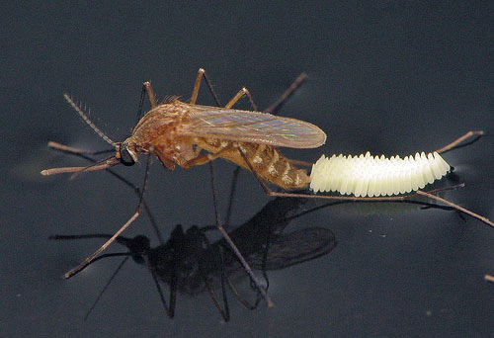
Mosquito Egg
Laid on or near the water
Photograph by Sean McCann, UF/IFAS Entomology Database

Slide 20
Mosquito Larvae
Siphon
Live in the water
Breathe using a siphon
Growing stage
Eat a lot!
This stage can take as little as 4 days!
Photograph by Michele Cutwa, UF/IFAS Entomology Database

Slide 21
Mosquito Pupae
Trumpet
Live in the water
Breathe using trumpets
Transformation stage
1-2 days
Photograph by Ray Wilson, UF/IFAS Entomology Database

Slide 22
Mosquito Adult
Final life stage
Mouthparts = proboscis
Live on land and fly around
Adults can live weeks to months
Proboscis

Slide 23
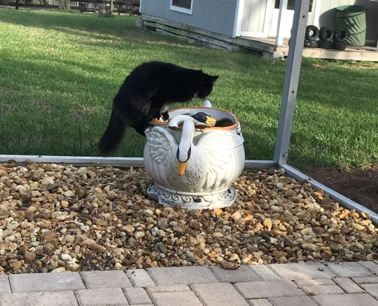
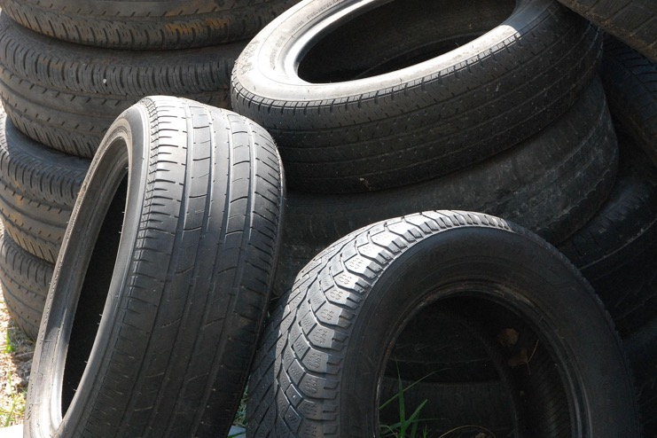
Container mosquitoes
Photograph by Michael Cossaboom
Lay their eggs in containers
Photograph by Johann Jaritz
Photograph by Casey Parker
Notes:
80 mosquito species in FL
3,500 in the whole world

Slide 24
Container mosquitoes
Lay their eggs in containers
LOVE to feed on people!
UF/IFAS File Photo
Notes:
80 mosquito species in FL
3,500 in the whole world

Slide 25
Container mosquitoes
Lay their eggs in containers
LOVE to feed on people!
Bite during the day
Photograph by James Gathany, Centers for Disease Control and Prevention
Notes:
80 mosquito species in FL
3,500 in the whole world

Slide 26
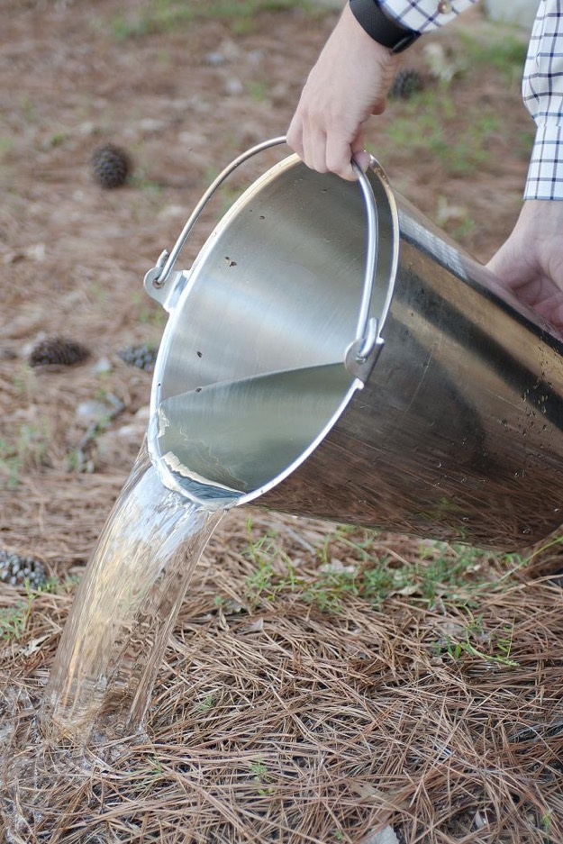
Container mosquitoes
Lay their eggs in containers
LOVE to feed on people!
Bite during the day
How do we get rid of container mosquitoes?
Get rid of the water where they live!
Photograph by Lauren Bishop, Centers for Disease Control and Prevention
Notes:
80 mosquito species in FL
3,500 in the whole world

Slide 27
Why are container mosquitoes important?
Because they can make us (and our pets) sick!
Container mosquitoes transmit disease
Humans
Dengue
Chikungunya
Zika
Dogs
Heartworm
Graphic produced by the CDC

Slide 28
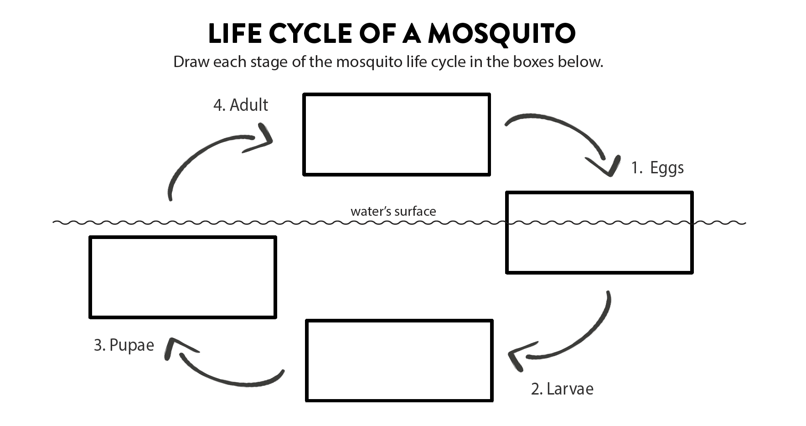
Activity

Slide 29
Activity

